Slide 1
Future of Embedded Navigation for Consumer Devices & Connected Vehicles
ACAMP Advanced Embedded Systems, Sept 9, 2015
Notes:
Talk about agenda of talk:
Background of InvenSense and the Canada division located in Calgary
State of navigation & location products today
Next generation embedded navigation products

Slide 2
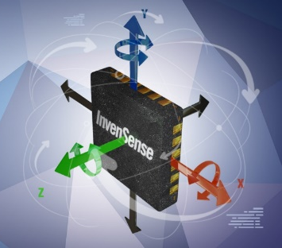
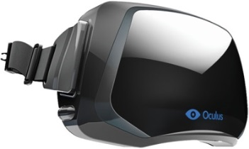
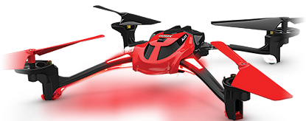
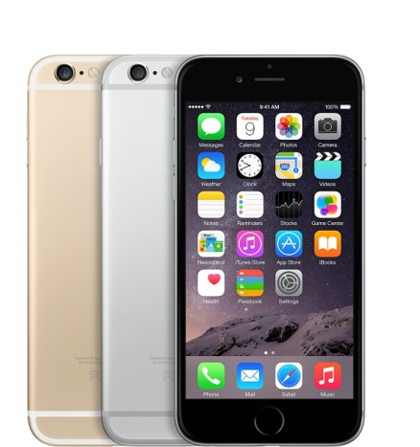
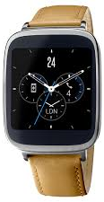
InvenSense Inc. Overview
Products | Sensing Everything Over 1 billion consumer gyroscopes shipped worldwide 80% worldwide consumer 6 axis/gyro market share Phones, wearables, drones, VR/AR…
Headquarters Offices | Silicon Valley (San Jose, CA) Calgary, China, Japan, Taiwan, Slovakia, Boston France, Korea, Milan
Employees | > 650
Revenue | FY12: $153M FY13: $209M FY14: $253M FY15: $372M
Note: Company fiscal year ends Sunday closest to March 31.
2
Notes:
Focus on products bullet and revenue growth

Slide 3

InvenSense Canada
InvenSense Canada was previously Trusted Positioning Inc.
InvenSense acquired Trusted Positioning in 2014
20+ Calgary employees
U of C spin-out (2009)
Software deployed on millions
of devices worldwide (2014+)
SW platform company
Navigation SW products
Tier-1 global customers including smartphone manufacturers
Globally recognized team
30+ patents filed, 400+ papers
80+ person years development
Acquired by InvenSense
in 2014 for $36M USD

Slide 4











































Diverse and Global Customers
Notes:
All the big names in customers

Slide 5




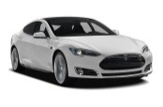









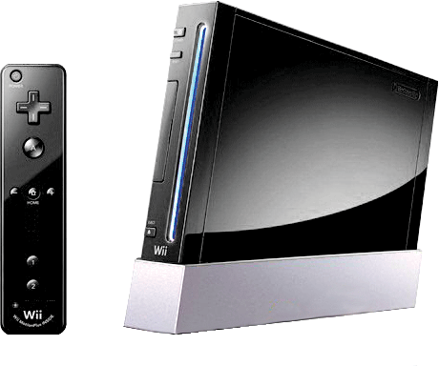

Component to Solution Transformation
Location Based Services
Wearable Computing
>3 BU
Industrial/Automotive
Activity Monitoring
Image Stabilization
Appliances
Sport & Fitness
Smart TVs
Tablets
Toys
Smart Phones
Gaming
Imaging
2008
2010
2012
2015
Notes:
Lots of cool applications, Calgary team is the best inertial navigation team in the world looking to enable mainstream next generation location based services, such as indoor location.

Slide 6








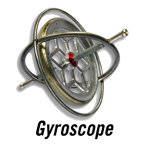
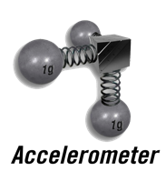

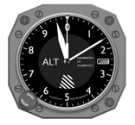


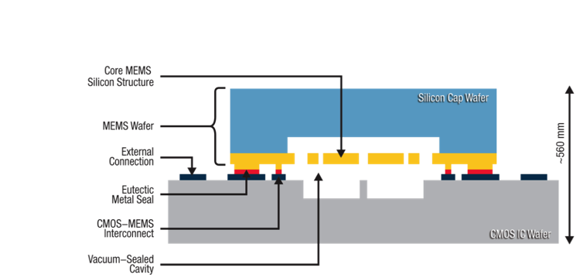
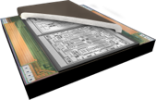
InvenSense Technology
Software/System
Integration
MotionApps
Sensor based Navigation Assist
Optical Image Stabilization
Ui/Ux
Algorithms
MotionFusion
Runtime Calibration
Classification
Gestures
SoC Integration
MEMS Technology to MotionTracking Solution
Device I/O
6/7/9 Axis Inertial Sensors
3th Gen Digital Motion Processor
FIFO/Memory
Power Management
Memory
Gyro
Accel
ARM
Mag
DMP4
DMP3
Pressure
Sensor Integration
Pressure
Audio
Process Technology
Notes:
Transition, from best sensor hardware to software and system integration

Slide 7

Navigation Status

Slide 8
Integrated Navigation Solutions
Vehicle
Pedestrian
Indoor

Slide 9




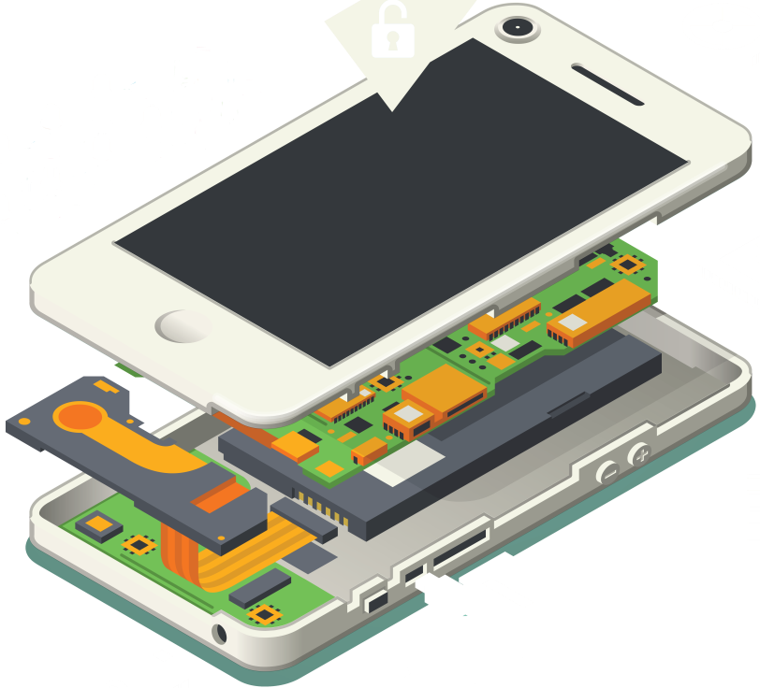
InvenSense Positioning Library
[
]
=
Continuous & Accurate
Positioning
+
+
IPL
Sensors
INVN Positioning
Library
(IPL)
Sensors on the mobile
Accelerometers
Gyroscopes
Magnetometers
Barometer
Speed sensors
Camera

Slide 10
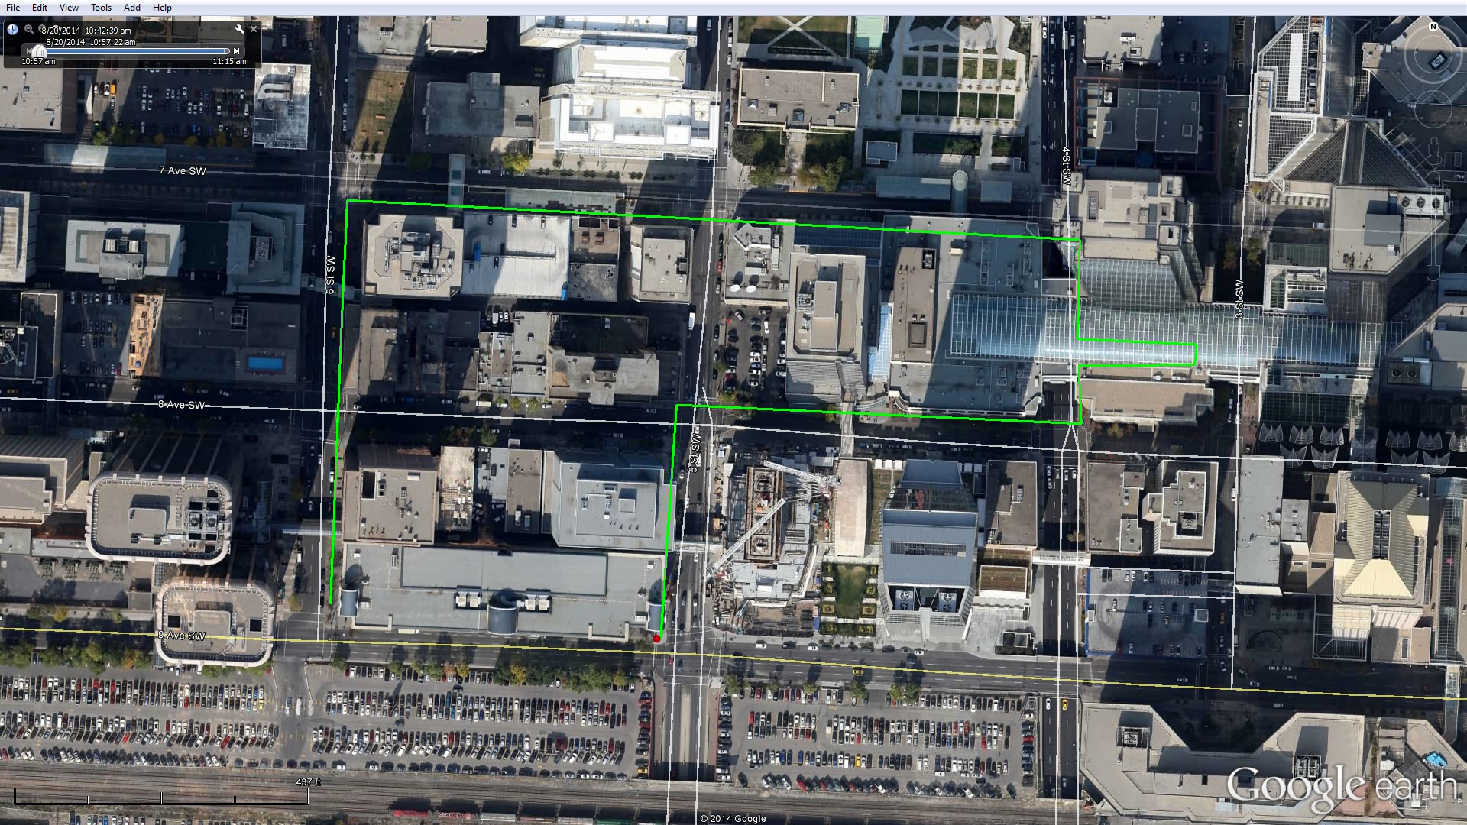
Calgary Walk Outdoors/Indoors
Slow GNSS Re-acquision. IPL continues tracking
Medium GNSS Multipath
Indoors approx 3 minutes. No GNSS
 |  | Distance [m] | Horizontal Error [m] |  | Heading Error [deg]
 | Avail. | Reference 995.8 m | 67% | 95% | 67% | 95%
IPL | 100% | 995.0 | 19.0 | 32.2 | 7.5 | 14.0
GNSS | 86% | 1087.2 | 26.4 | 48.0 | 30.3 | 118.2
% | 14% | 9% | 28% | 33% | 75% | 88%
IPL
GNSS

Slide 11
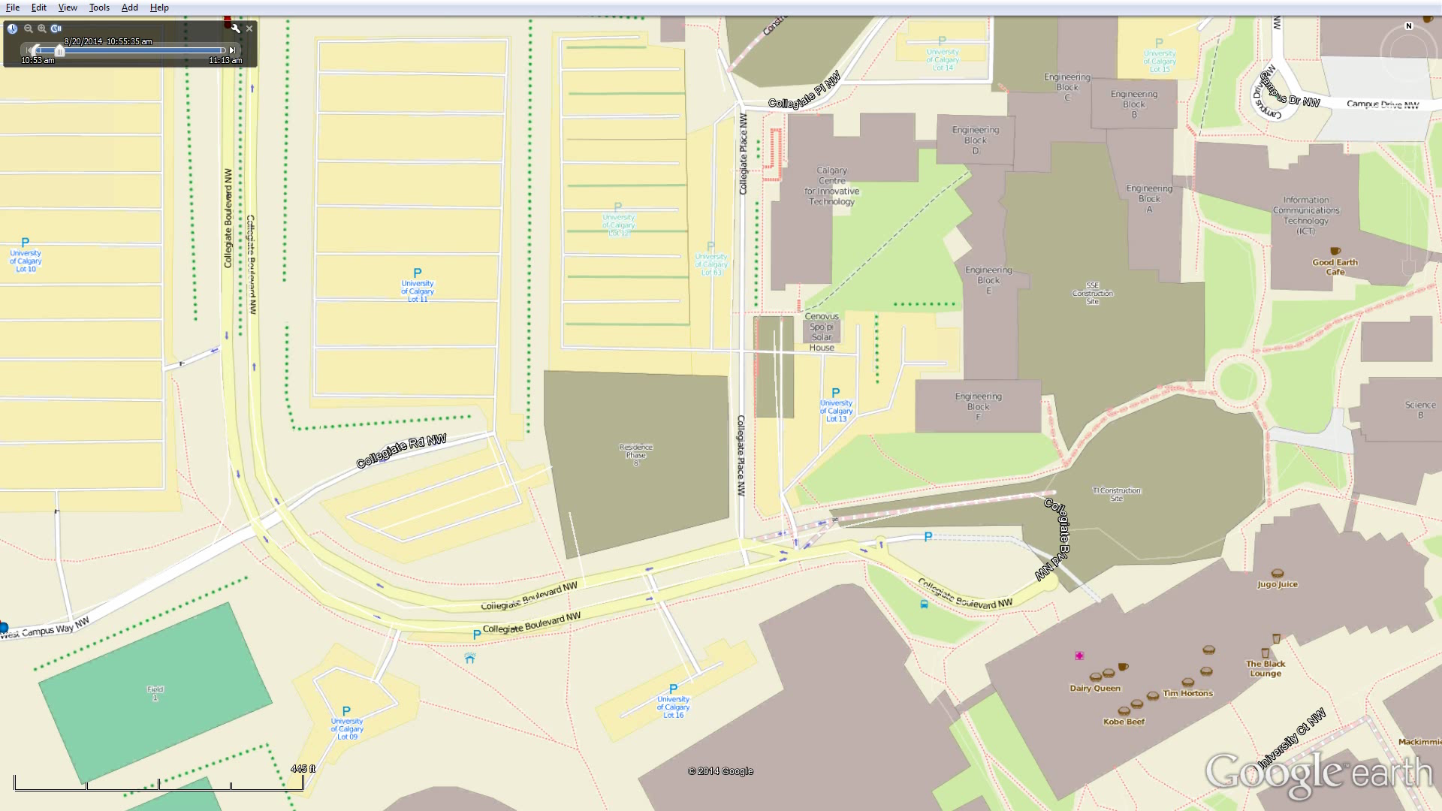
Drive & Walk, Park Outdoors
Downstairs
Upstairs
Walking Outdoors
Walking Indoors for 3 minutes. No GNSS or WiFi
IPL tracks underground
Entering underground parking lot. GNSS lost.
IPL (Driving)
IPL (Walking)
GNSS
Parking Location

Slide 12
Drive & Walk, Context from previous slide
IPL
Standing
Escalator Standing
Escalator Walking
Stairs
Elevator
Walking
Driving

Slide 13
ICM 20635 Solution Topology
MCU or AP
IPL
ICM-20635
Sensor HAL
Sensor Calibration
Sensor Location Engine
GNSS
Sensors
Inv SW on DMP
IPL API
Location Fusion Engine
Raw data
Sensor Fusion
InvenSense ICM-20635 device
+
InvenSense Positioning Library
Optimized for navigation

Slide 14
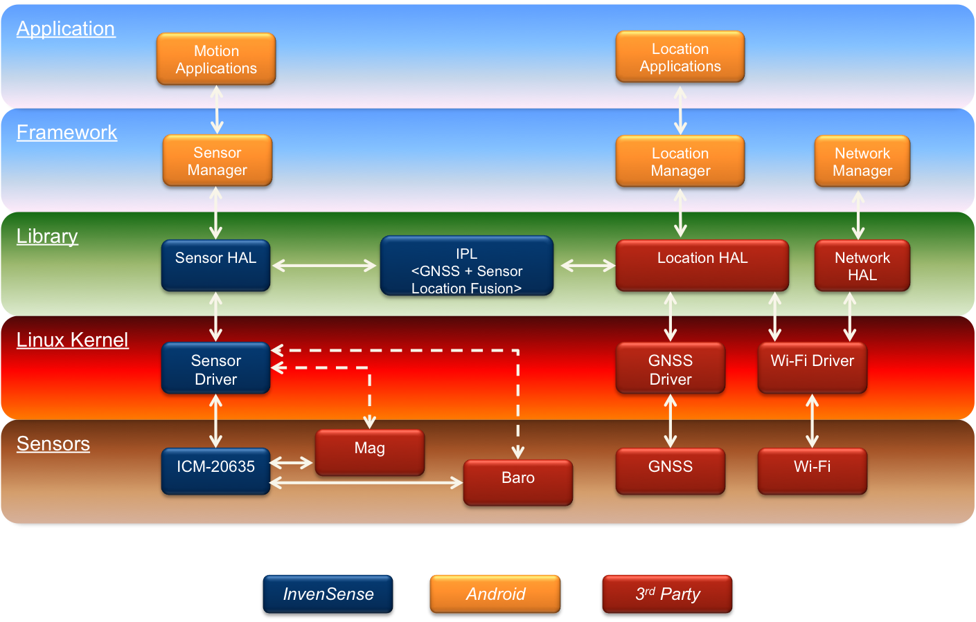
Android Integration
Existing Android Location Manager API can be used
IPL as shared object with clearly defined APIs
Sample code & porting guide for integration on Android

Slide 15
Navigation Future

Slide 16
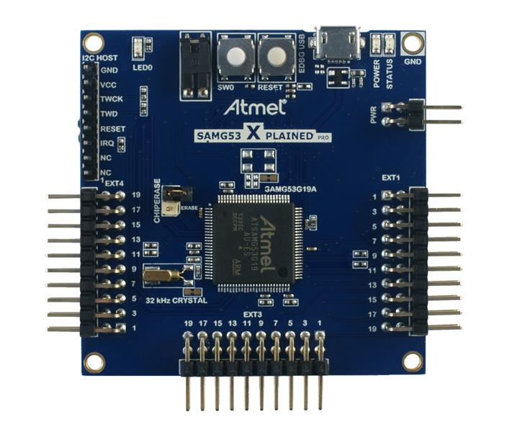
Always-ON Location & Tracking
Next generation smartphones coming equipped with lower level microcontrollers
  Always-on location hub
  GNSS + Wi-Fi + sensors + maps +…
Microcontrollers will reduce power significantly
  Current AP-based location solutions can consumer over 100 mA
  Next generation microcontroller location solutions will consume less than 10 mA

Slide 17
Example – IPL on an Atmel SAMG53
  ARM Cortex-M4 with FPU;
  512 Kbytes embedded Flash, 96 Kbytes embedded SRAM
  Running at 16 MHz
IPL
Resources
MIPS
  4 MIPS for IPL
  <20% of 16MHz Cortex M4
Power:
  < 1 mA for SW to process GNSS + sensors measurements in to location estimates

Slide 18
Always-ON Enabled Applications
Indoor location
  Shopper path re-creation
  E911 person finder
  Child finder
  Gaming…
Indoor crowdsourcing of wireless signals
Outdoor GPS duty cycling (i.e. turn GPS off)
  Sensors < 2 mA
  GNSS > 5 mA

Slide 19
Connected Vehicle + Devices
Lots of sensors & GNSS receivers!
Vehicle
  In-dash nav units
  Sensors
  Wheel ticks
  Steering angle…
Devices
  Multiple phones in a vehicle
  Smartwatches
  Tablets/iPads
Not just about navigation, can also get analytics of driving styles and who’s using what devices…

Slide 20
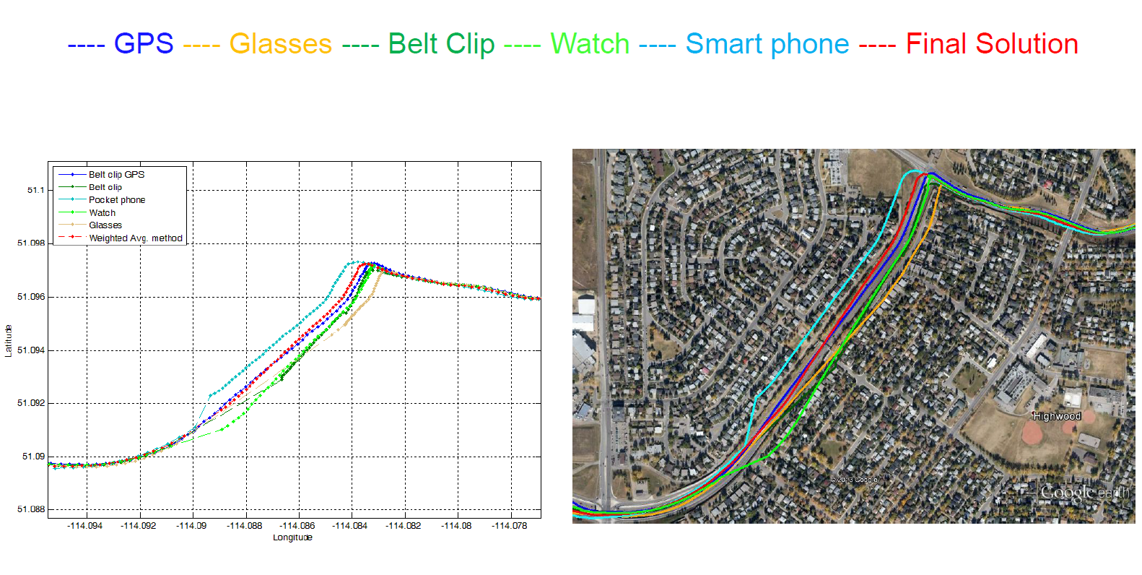
Future: Integrating more Sensors
More Devices = More Sensors
Increased accuracy & reliability

Slide 21
We are Hiring!
Come by and talk to me F2F
Current open position:
  iOS Developer (3-6 years experience)
Always Hiring
  The best navigation algorithm designers
    Geomatics or Electrical engineering grads with MSc’s and/or PhD’s preferred
  Software developers
    Strong C background mandatory
    Mobile OS experience preferred (Android, iOS, Linux, Windows)

Slide 22
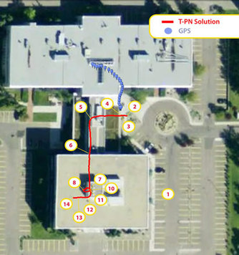
My Contact Info
Chris Goodall
cgoodall@invensense.com
Suite 311, 3553 31 Street NW
Calgary, AB

