Slide 1
Dynamic
Real-time
Lane Modeling
June 2015
Purser Sturgeon II
+1.210.522.3924
psturgeon@swri.org

Slide 2
Needs and Problem
V2V safety applications are focused around the BSM
Vehicle trajectory information at 10Hz
Current map data is focused on navigation and routing
Primarily proprietary sources (Google, NAVTEQ, TeleAtlas, others)
Insufficient accuracy (5-15 meters typically)
No lane level resolution
Updates are done annually (or slower) for national databases
Commercial databases can be update continuously, but are only republished every 1 to 6 months

Slide 3
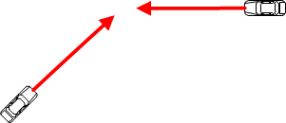
Needs and Problem
Vehicle | Speed | Acceleration
A | 20 m/s | -0.1 G
B | 15 m/s | +0.5 G
B
A
25 m

Slide 4
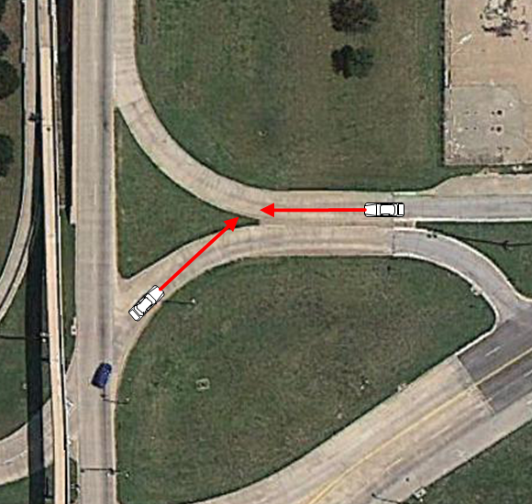
Needs and Problem
Vehicle | Speed | Acceleration
A | 20 m/s | -0.1 G
B | 15 m/s | +0.5 G
B
A
25 m

Slide 5
Needs and Problem
Vehicle | Speed | Acceleration
A | 20 m/s | -0.1 G
B | 15 m/s | +0.5 G
B
A
25 m

Slide 6
Approach
Receive BSMs from nearby vehicles
Feed through an RSE into a common point to aggregate and analyze the data
Three separate algorithms were tested
Microsoft and Google had papers on determining roadways from vehicle data
Generally worked well for determining the center of a direction of travel, but did not scale well to provide parallel lanes
Third approach – machine learning algorithms
Prototyped several different types and variations
Modified implementation of a growing neural network

Slide 7
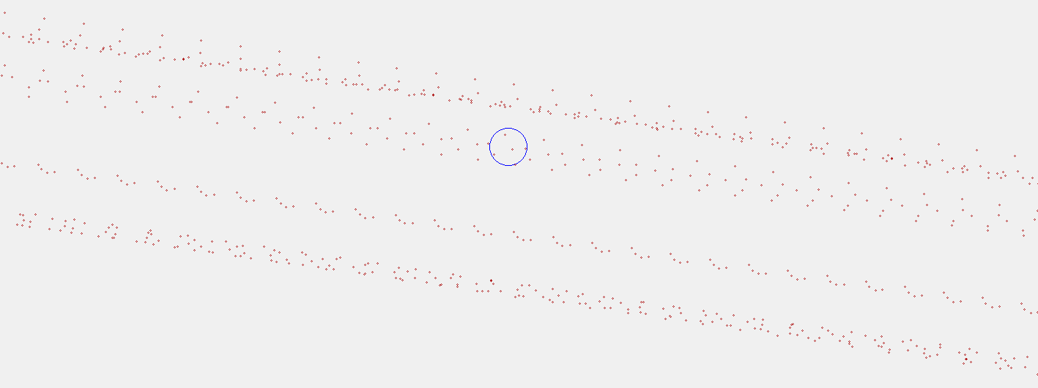
Approach - Input

Slide 8
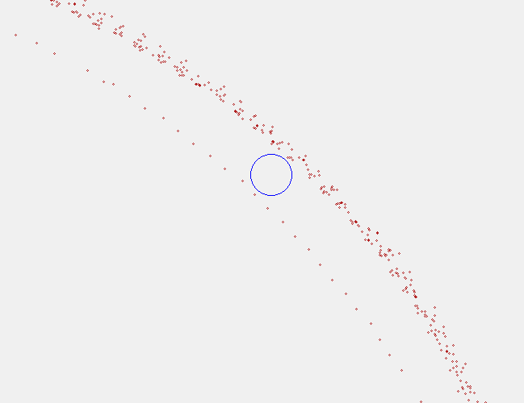
Approach - Input

Slide 9
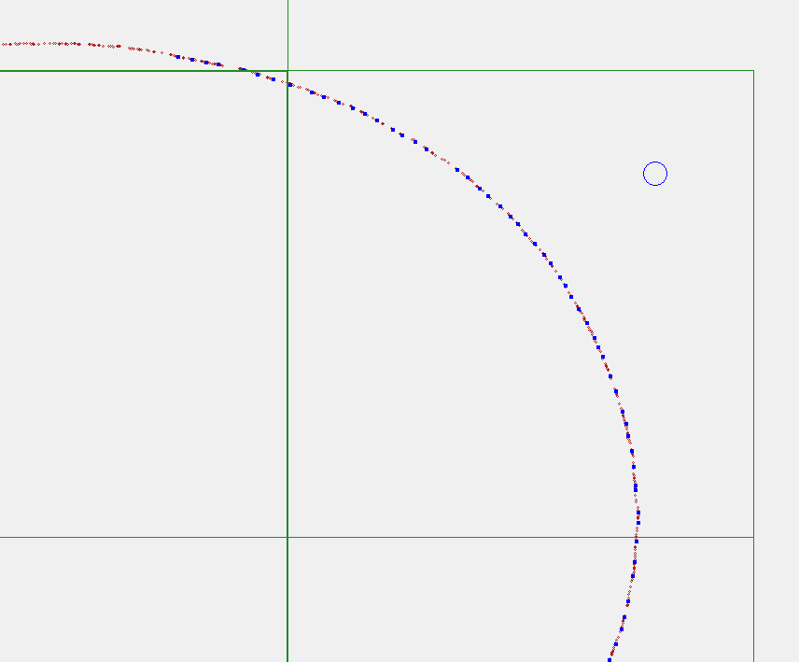
Results

Slide 10
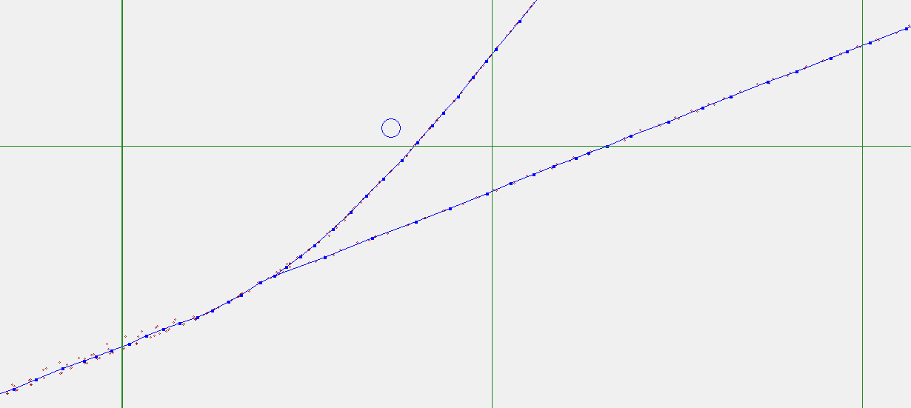
Results

Slide 11
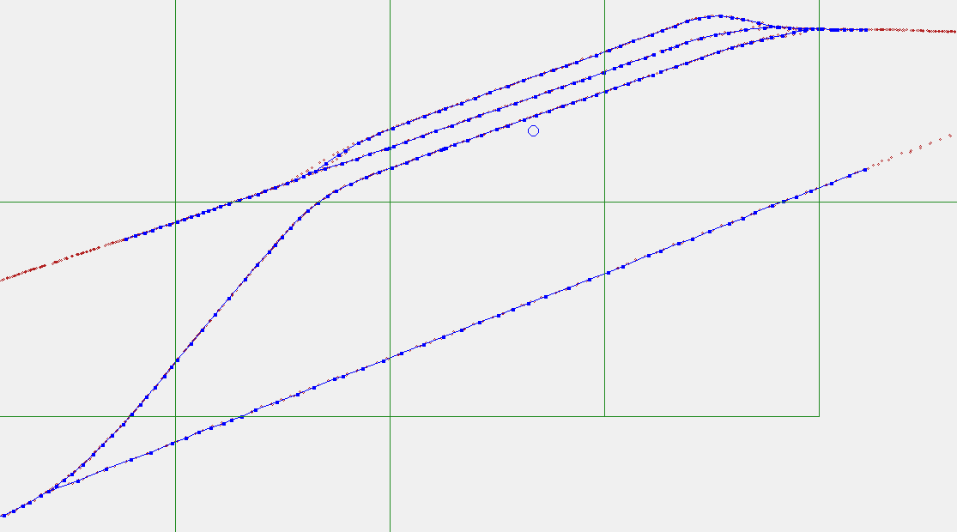
Results

Slide 12
Results – Videos 4 Parallel lanes

Slide 13
Results – Videos Whole Track

Slide 14
Results – Videos Track Intersection Lanes

Slide 15
Results – Track Intersection
#START
29.4502524562077,-98.6170686129295,18,6.400
29.4502910841023,-98.6170196217935,1
#END
#START
29.4502524562077,-98.6170686129295,18,29.994
29.4503625142364,-98.6167861172454,36,158.177
29.4509501283378,-98.6152999872478,192
#END
#START
29.4500680531564,-98.6175299548725,9,49.189
29.4502524562077,-98.6170686129295,18
#END
#START
29.4504388963365,-98.6175291746872,12,42.522
29.4506417545844,-98.6171572641109,520,21.824
29.4507127219394,-98.6169473839536,483
#END
#START
29.4510585889656,-98.6174840496424,307,4.682
29.4510446640646,-98.6175296084615,302
#END
#START
29.4512814654047,-98.6169175330048,274,17.441
29.4512161109272,-98.6170811315715,250,13.462
29.451166557049,-98.6172078682432,252,25.911
29.4510713116887,-98.6174518384007,309,3.430
29.4510585889656,-98.6174840496424,307
#END
#START
29.450888466685,-98.6164876023249,385,13.374
29.450948407076,-98.6163680898593,389,62.172
29.4511442894513,-98.6157672593891,147,4.034
29.4511355491247,-98.6157268079916,175
#END
#START
29.4507371875572,-98.6168749071575,539,37.707
29.450869630085,-98.6165168835382,586
#END
#START
29.4514907271858,-98.6163740564733,555,13.315
29.45144348447,-98.6165002317802,240,19.336
29.451372297395,-98.6166822432179,207,7.007
29.4513481396644,-98.6167490219554,259,12.844
29.4512991740815,-98.616869067131,266
#END
#START
29.4503150454438,-98.6169904024237,574,24.378
29.4504853040624,-98.6168319565289,529,44.823
29.4508056038462,-98.6165509670535,103,3.093
29.4508230817983,-98.6165260360556,532
#END
#START
29.4508544401398,-98.6164615802355,593,81.516
29.4511219270732,-98.6156785582885,465,16.309
29.4511253031177,-98.6155103684478,152,20.410
29.4511213257073,-98.6152998223543,183
#END

Slide 16
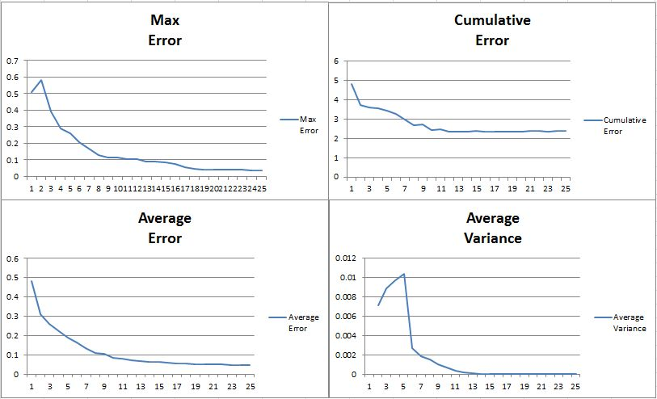
Results

Slide 17
Benefits

Slide 18
Thank You
Purser Sturgeon II
+1.210.522.3924
psturgeon@swri.org
18

