Slide 1
Advanced Automotive Safety Systems Industry Trends and Initiatives
ACAMP Seminar Series: Advanced Embedded Systems – Sep 09, 2015

Slide 2
Agenda
Welcome and Introductory Comments
Industry Trends
Invotek Product Focus
Government/University/Industry Collaboration
APMA and the Connected Vehicle Initiatives
Wrap Up

Slide 3
Welcome and Introductory Comments
EARL HUGHSON – President and Co-Founder , Invotek Electronics Inc.
30+ years of P&L and Executive Management responsibilities, launching & developing OEM automotive & non-automotive technology enterprises for Magna, C-MAC, Solectron, Flextronics inc
Production sales growth from green field launch to >$175MM in annual revenue.
R&D, product development, manufacturing , and marketing expertise and numerous international partnerships in OEM and in rugged E/E systems
Companies achieved ISO 9001, QS 9000,TS 16949, ISO 14001, OHSAS 18001, and ISO 17025 certifications while maintaining world class production metrics (6 sigma PPM etc.)
BASc Engineering– University of Waterloo, On
3

Slide 4
Automotive Sensors…. And the Connected Vehicle
In 2014, 85 million vehicles were produced.
By 2020, this will grow to 110 million vehicles globally.
Today, there are 60 - 100 sensors per vehicle.
This will climb to 200 sensors per vehicle over the next 5 years.
This significant growth is driven by:
Improving safety systems
Autonomous vehicle initiatives
Increasing demands on improving fuel economy
By 2020, the market demand for sensors needed in these applications will grow to 22 billion units, annually.

Slide 5
Market Opportunity: Addressable Market Size
The market for advanced driver assist systems is growing rapidly, driven by positive fundamental in regulation as well as OEM directed differentiation
Sensor Market Size
$ in Millions

Slide 6
360 Degrees of Situational Awareness

Slide 7
Market Challenge & Opportunity
Sensor integration is a complex problem for OEM’s who must balance cost, performance, styling, safety, market and regulatory demands and complex system integration

Slide 8
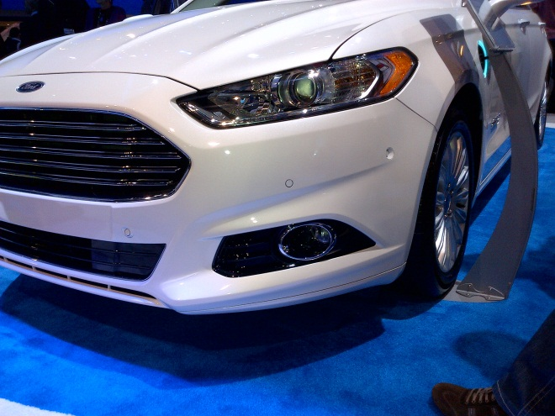
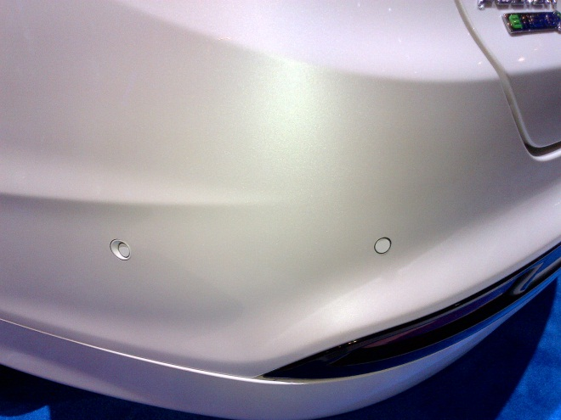
Market Challenge & Opportunity
In most cases, vehicle styling and design needs to be “disrupted” to accommodate today’s advanced sensors.
Invotek’s strategy is to develop sensors that:
Reduce the quantity of sensors needed to achieve a given sub-system performance level
“Seamlessly” integrate sensors within existing vehicle systems
Minimize the styling “disruptions”
Provide the OEM with a positive cost/benefit business case

Slide 9
Invotek Electronics Value Proposition
Invotek is developing and commercializing a suite of advanced safety sensors with an emphasis on:
Ease of integration
Small form factor
Increased field of view
Elimination of traditional packaging constraints
Invotek’s objective is to offer sensors that adapt to the vehicle environment.
Advanced Camera Systems
Advanced Ultrasonic Sensor Assemblies
Compact 77 GHz Radar Systems

Slide 10
Collaborative Development Partners
Micralyne
Acamp - Alberta Centre for Advanced MNT Products
University of Alberta
University of Waterloo
CMC Microsystems

Slide 11
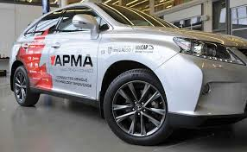
APMA and the Connected Vehicle
Connected Vehicle Working Group (CVWG)
Identifies and promotes Canadian companies with technologies, products, and services related to the Connected Vehicle
The CVWG consists of OEM’s, Tier 1’s, SME’s, Academia, and the Federal/Provincial governments
The CVWG attracts many companies from outside the traditional automotive supply base

Slide 12
Wrap Up
If you are interested in learning more about Invotek Electronics, or if you have a technology suitable for automotive applications please contact:
Earl Hughson, President, earlhughson@invotekinc.com
Dave Patterson, Director of Business Development, davepatterson@invotekinc.com
Thank You!

